Slide 1
Chapter 6 Delivery and Routing of IP Packets

Slide 2
Outline
Delivery
Forwarding
Structure of a Router

Slide 3
Delivery v.s. Routing
Delivery
The way a packet is handled by the underlying networks under the control of the network layer
Direct v.s. indirect delivery
Forwarding
The way a packet is delivered to the next station
Forwarding based on destination address
Forwarding based on the label

Slide 4
6.1
Delivery
The McGraw-Hill Companies, Inc., 2000

Slide 5
Delivery
Delivery of a packet
The network layer supervises the handling of the packet by the underlying physical networks
Two method
Direct versus indirect delivery

Slide 6
Direct Delivery
The final destination is a host in the same physical network as the deliverer
When the source and destination are located on the same physical network
Or the delivery is between the last router and the destination host

Slide 7
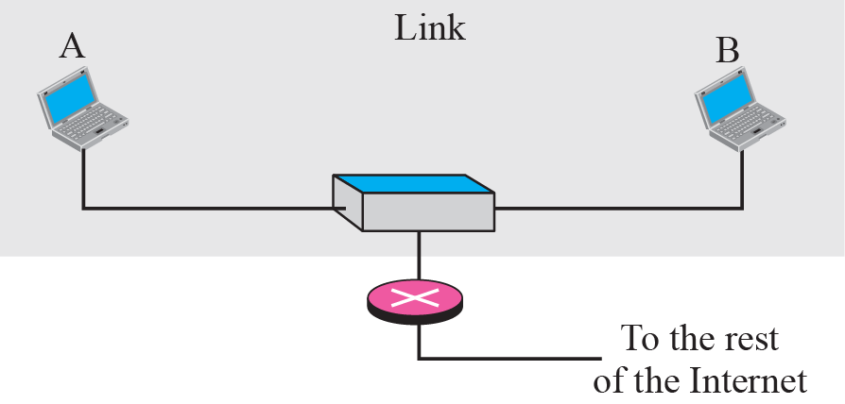
Figure 6-1
Direct Delivery
The McGraw-Hill Companies, Inc., 2000

Slide 8
Direct Delivery (Cont.)
How to determine if the delivery is direct
Compare the network addresses between the destination and the current network
For direct delivery, the sender uses the destination IP address to find the destination physical address
Static method: finding a table
Dynamic method: use the address resolution protocol (ARP)

Slide 9
Indirect Delivery
The destination host and the deliverer are not on the same network
Packet goes from routers to routers
For indirect delivery
The sender uses the destination IP address and a routing table to find the next router’s IP address
Then, the sender uses ARP protocol to find the next router’s physical address

Slide 10
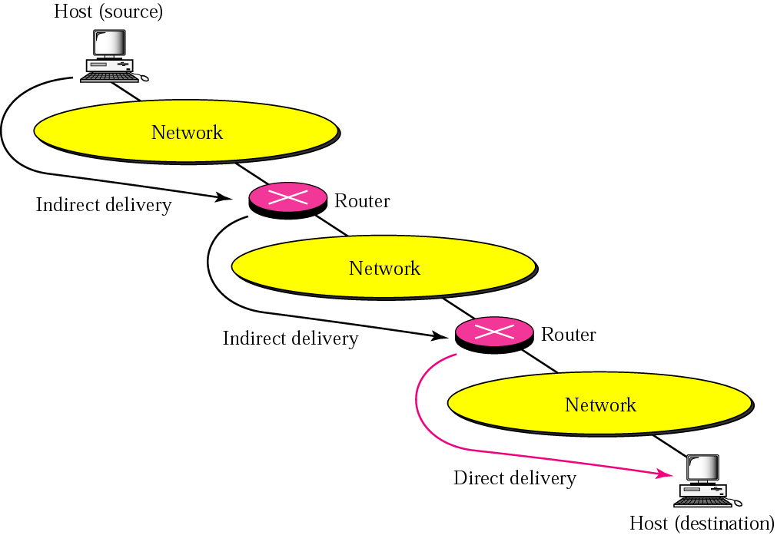
Figure 6-2
Indirect Delivery
The McGraw-Hill Companies, Inc., 2000

Slide 11
Indirect Delivery (Cont.)
A delivery always involves one direct delivery but zero or more indirect deliveries
Besides, the last delivery is always a direct delivery

Slide 12
6.2
Forwarding
The McGraw-Hill Companies, Inc., 2000

Slide 13
Forwarding
Forwarding: place the packet in its route to its destination
Two methods
If IP is a connectionless protocol,
Forwarding is based on the destination addresses of the IP datagram
If IP is a connection-oriented protocol
Forwarding is based on the label attached to an IP datagram

Slide 14
Forwarding Based on Destination Address
Forwarding requires a host/router to have a routing table
However, with the increase of hosts,
The number of entries in the routing table also increase
Techniques to decrease the routing table size and handle issues such as security
Next-hop routing
Network-specific routing
Host-specific routing
Default routing

Slide 15
Next-Hop Routing
Routing table holds only the address of the next hop
Instead of holding information about the complete route

Slide 16
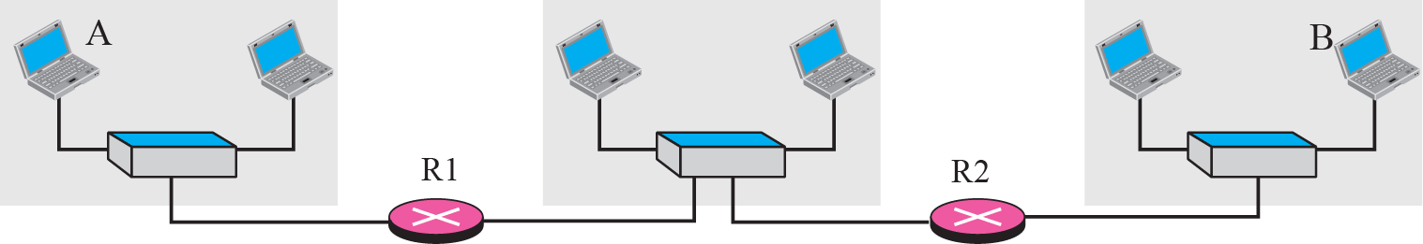
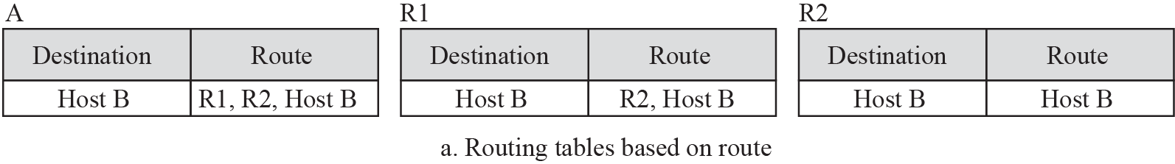
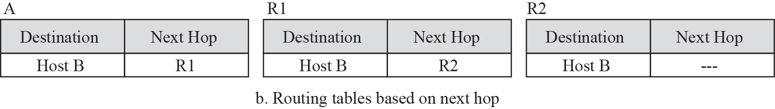
Figure 6-3
Next-Hop Routing
The McGraw-Hill Companies, Inc., 2000

Slide 17
Network-Specific Routing
Use only one entry to define the address of the network itself, i.e., network address
Instead of having an entry for every host connected to the same physical network

Slide 18
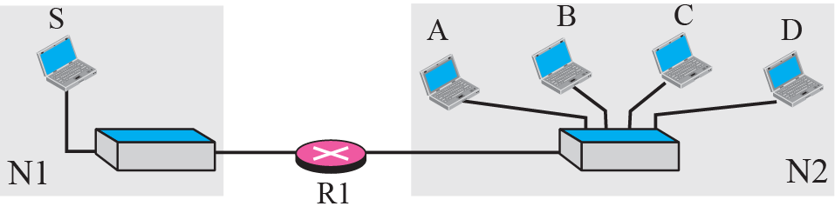
Figure 6-4
Network-Specific Routing
The McGraw-Hill Companies, Inc., 2000

Slide 19
Host-Specific Routing
The destination host address is given in the routing table
The inverse of network-specific routing
Not efficient for performance
But, in some occasions, the administrator wants to have more control over routing
Checking the route
Providing security

Slide 20
Figure 6-5
Host-Specific Routing
R1
Assume that the path from R3
to B is insecure
The McGraw-Hill Companies, Inc., 2000

Slide 21
Default Routing
Instead of listing all networks in the routing table
Just use one entry called default
Network address is 0.0.0.0

Slide 22
Figure 6-6
Default Routing
The McGraw-Hill Companies, Inc., 2000

Slide 23
Forwarding Classification
Forwarding with Classful Addressing
Forwarding without subnetting
Forwarding with subnetting
Forwarding with Classless Addressing

Slide 24
Forwarding without Subnetting
The existence of a default mask in a classful address makes for forwarding process simple
Most routers in classful addressing are not involved in subnetting
Since subnetting happens inside an organization
A forwarding module would consists of three tables
One for each unicast class
If support multicast, add one more table to handle class D addresses

Slide 25
Forwarding without Subnetting
Each routing table has a minimum of three columns
Network address of the destination network
Assume use the network-specific forwarding, not the host-specific forwarding
Next-hop address
Tell which router the packet must be delivered for an indirect delivery
Empty for a direct delivery
Interface number
Define the outgoing port from which the packet is sent out

Slide 26
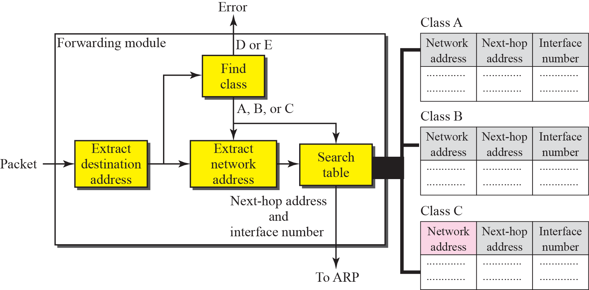
Simplified Forwarding Module in Classful Address without Subnetting

Slide 27
Steps of Forwarding without Subnetting
Extract the destination address of the packet
Make a copy of the destination address and find the class of its address
Shift the copy of the address 28 bits to the right
The result is a 4-bit number used to determine the class
Use the result in steps 2 to extract the network address
By masking off the rightmost 8, 16, or 24 bits since we have the mask now
The class of the address and the network address are used to find out next-hop information
The class determines the table to be searched
Then search the table for the network address
If found, use the next-hop address and the interface number; else, use the default route
Use the ARP module to find the physical address of the next router
By the next-hop address and the interface number

Slide 28
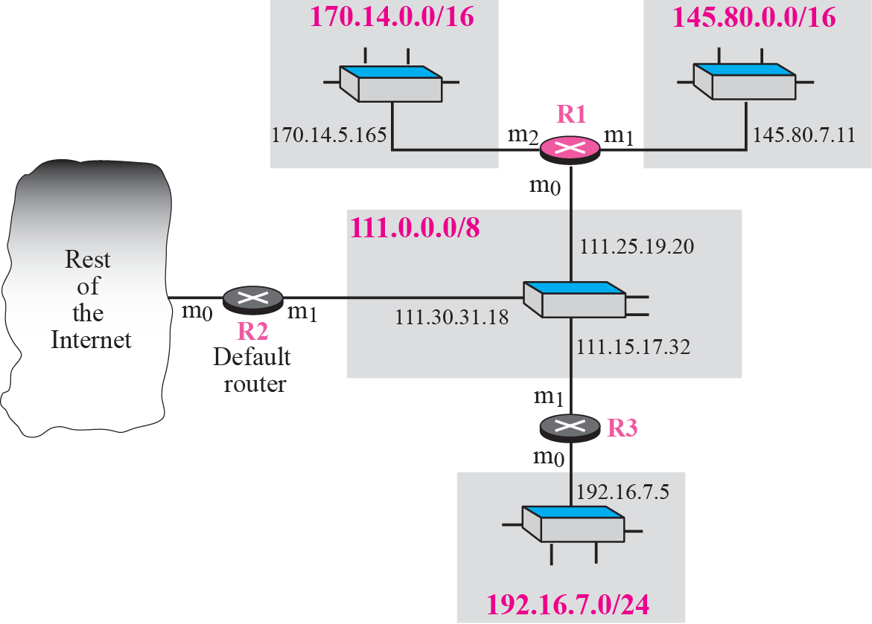
Example 6.1
Show the routing table for router R1

Slide 29
Example 6.1: Solution
Following figure shows the three tables used by router R1.
Some entries in the next-hop address column are empty
Because the destination is in the same network to which the router is connected (direct delivery).
Thus, the next-hop address used by ARP is simply the destination address of the packet

Slide 30
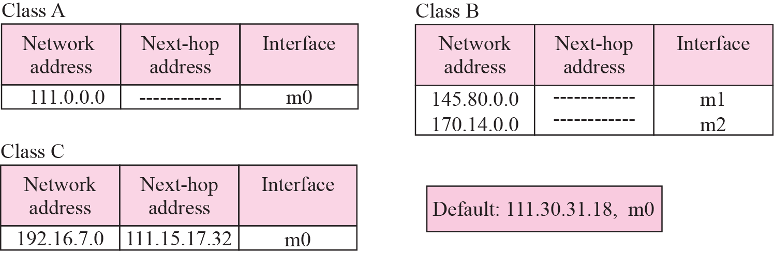
Table for Example 1

Slide 31
Example 6.2
Router R1 in above figure receives a packet with destination address 192.16.7.14. Show how the packet is forwarded
Solution
The destination address is 11000000 00010000 00000111 00001110.
A copy of the address is shifted 28 bits to the right. The result is 00000000 00000000 00000000 00001100 or 12.
The destination network is class C.
The network address is extracted by masking off the leftmost 24 bits of the destination address; the result is 192.16.7.0.
The table for Class C is searched and the network address is found in the first row.
The next-hop address 111.15.17.32. and the interface m0 are passed to ARP

Slide 32
Example 6.3
Router R1 in above figure receives a packet with destination address 167.24.160.5. Show how the packet is forwarded.
Solution
The destination address is 10100111 00011000 10100000 00000101.
A copy of the address is shifted 28 bits to the right. The result is 00000000 00000000 00000000 00001010 or 10.
The class is B.
The network address is 167.24.0.0.
The table for Class B is searched.
No matching network address is found.
The packet needs to be forwarded to the default router (the network is somewhere else in the Internet).
The next-hop address 111.30.31.18 and the interface number m0 are passed to ARP.

Slide 33
Forwarding Classification
Forwarding with Classful Addressing
Forwarding without subnetting
Forwarding with subnetting
Forwarding with Classless Addressing

Slide 34
Forwarding with Subnetting
In classful addressing, subnetting happens inside an organization
The routers that handle subnetting
At the border of the organization site
Inside the site boundary
Number of routing tables
If variable-length subnetting is used
We need several tables
Otherwise, only one is enough
P. 112 and 115 in Chapter 5

Slide 35
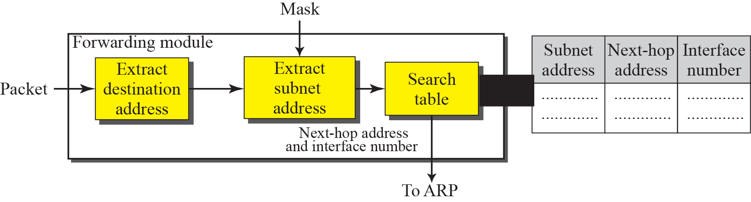
Simplified Forwarding Module in Classful Address with Subnetting

Slide 36
Steps in Forwarding with Subnetting
Extract the destination address of the packet
Extract the subnet address by the destination address and the subnet mask (p. 72 in chapter 5)
Search the table by the subnet address to find the next-hop address and the interface number
If no mach, use the default route
Pass the next-hop address and the interface number to the ARP

Slide 37
Example 6.4
Following figure 6.11 shows a router connected to four subnets
Note
The router is configured to apply the mask /18 to any destination address

Slide 38
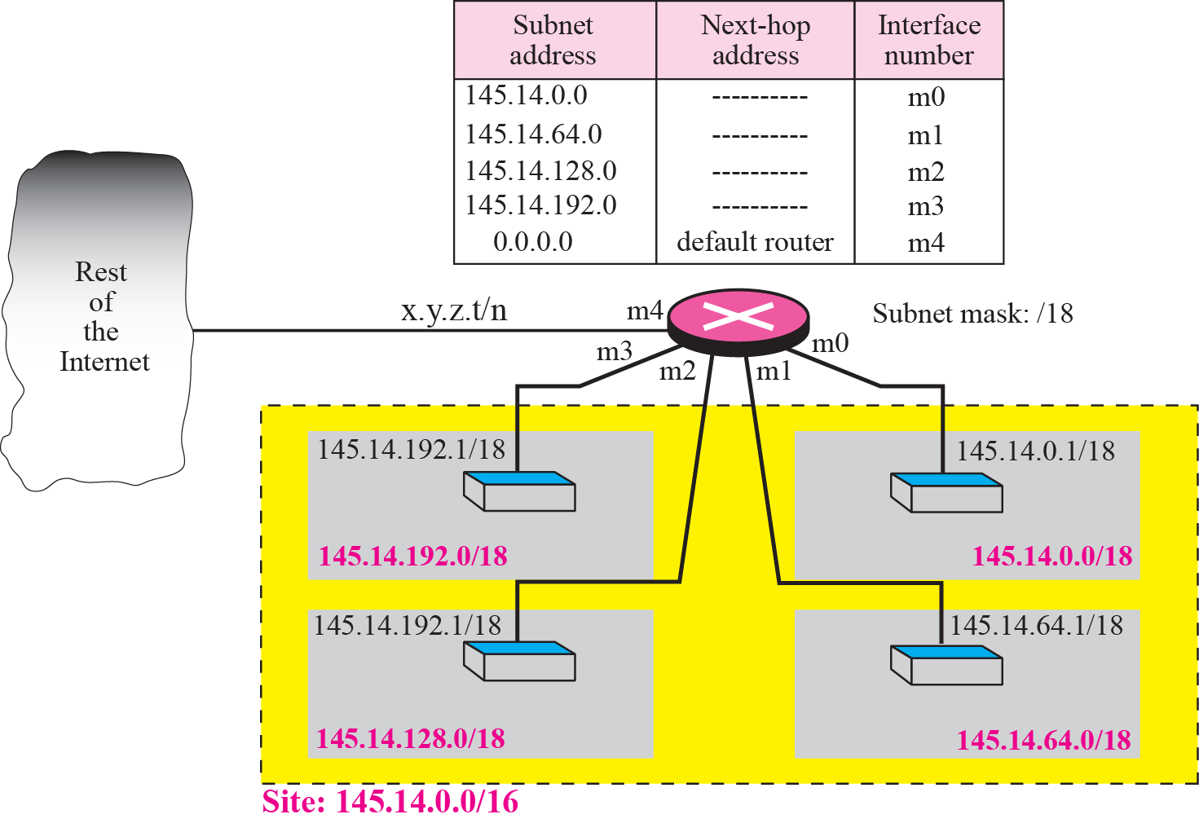
Figure 6.11 Configuration for Example 4

Slide 39
Example 6.5
The router in above figure receives a packet with destination address 145.14.32.78. Show how the packet is forwarded
Solution
The mask is /18.
After applying the mask, the subnet address is 145.14.0.0.
The packet is delivered to ARP with the next-hop address 145.14.32.78 and the outgoing interface m0

Slide 40
Example 6.6
A host in network 145.14.0.0 in above figure has a packet to send to the host with address 7.22.67.91. Show how the packet is routed
Solution
The router receives the packet and applies the mask (/18).
The subnetwork address is 7.22.64.0.
The table is searched and the address is not found.
The router uses the address of the default router (not shown in figure) and sends the packet to that router

Slide 41
Forwarding Classification
Forwarding with Classful Addressing
Forwarding without subnetting
Forwarding with subnetting
Forwarding with Classless Addressing

Slide 42
Forwarding with Classless Addressing
In classless addressing,
Cannot derive the network address from the destination address in the packet
Solution
Include the mask (/n) of the corresponding block in the table
Thus, a classless routing table needs at least four columns

Slide 43
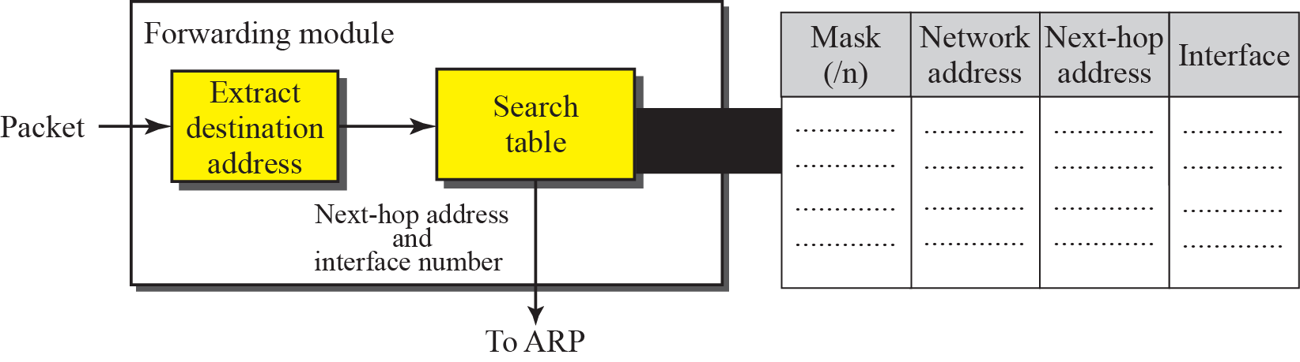
Simplified Forwarding Module in Classless Address

Slide 44
Example 6.7
Make a routing table for router R1 using the configuration in Figure 6.13
Solution:

Slide 45
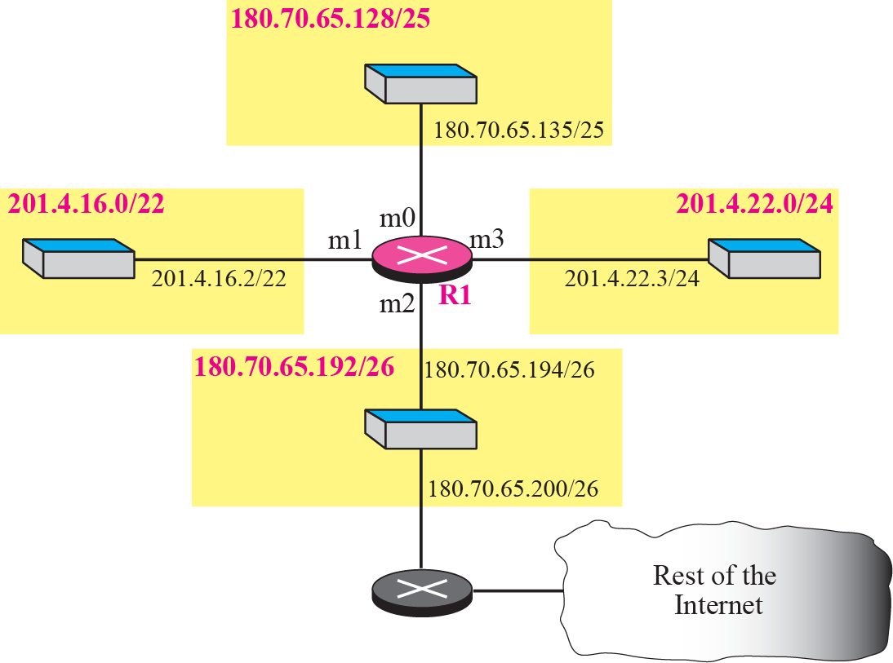
Configuration for Example 7

Slide 46
Example 6.8
Show the forwarding process if a packet arrives at R1 in above figure with the destination address 180.70.65.140
Solution: the router performs the following steps:
The first mask (/26) is applied to the destination address.
The result is 180.70.65.128, which does not match the corresponding network address
The second mask (/25) is applied to the destination address.
The result is 180.70.65.128, which matches the corresponding network address.
The next-hop address (the destination address of the packet in this case) and the interface number m0 are passed to ARP for further processing

Slide 47
Example 6.9
Show the forwarding process if a packet arrives at R1 in above figure with the destination address 201.4.22.35
Solution: the router performs the following steps
The first mask (/26) is applied to the destination address.
The result is 201.4.22.0 => (X).
The second mask (/25) is applied to the destination address.
The result is 201.4.22.0 => (X).
The third mask (/24) is applied to the destination address.
The result is 201.4.22.0 => (0)
The destination address of the package and the interface number m3 are passed to ARP

Slide 48
Example 6.10
Show the forwarding process if a packet arrives at R1 in above figure with the destination address 18.24.32.78
Solution
This time all masks are applied to the destination address, but no matching network address is found.
When it reaches the end of the table, the module gives the next-hop address 180.70.65.200 and interface number m2 to ARP.
This is probably an outgoing package that needs to be sent via the default router, to some place else in the Internet

Slide 49
Example 6.11
The routing table for router R1 is given in Table 6.2. Can we draw its topology?

Slide 50
Example 11: Solution
We know some facts but we don’t have all for a definite topology.
Router R1 has three interfaces: m0, m1, and m2.
There are three networks directly connected to router
110.70.0.0/16, 180.14.0.0/16, 190.17.0.0/16
There are two networks indirectly connected to R1
140.6.12.64/26 and 130.4.8.0/24
There must be at least three other routers involved
From the next-hop column

Slide 51
Example 11: Solution (Cont.)
One router, the default router, is connected to the rest of the Internet.
However,
We do not know if network 130.4.8.0 and 140.6.12.64 is directly connected to router R2 and R3 or through a point-to-point network (WAN) and another router.
Figure 6.14 shows our guessed topology

Slide 52
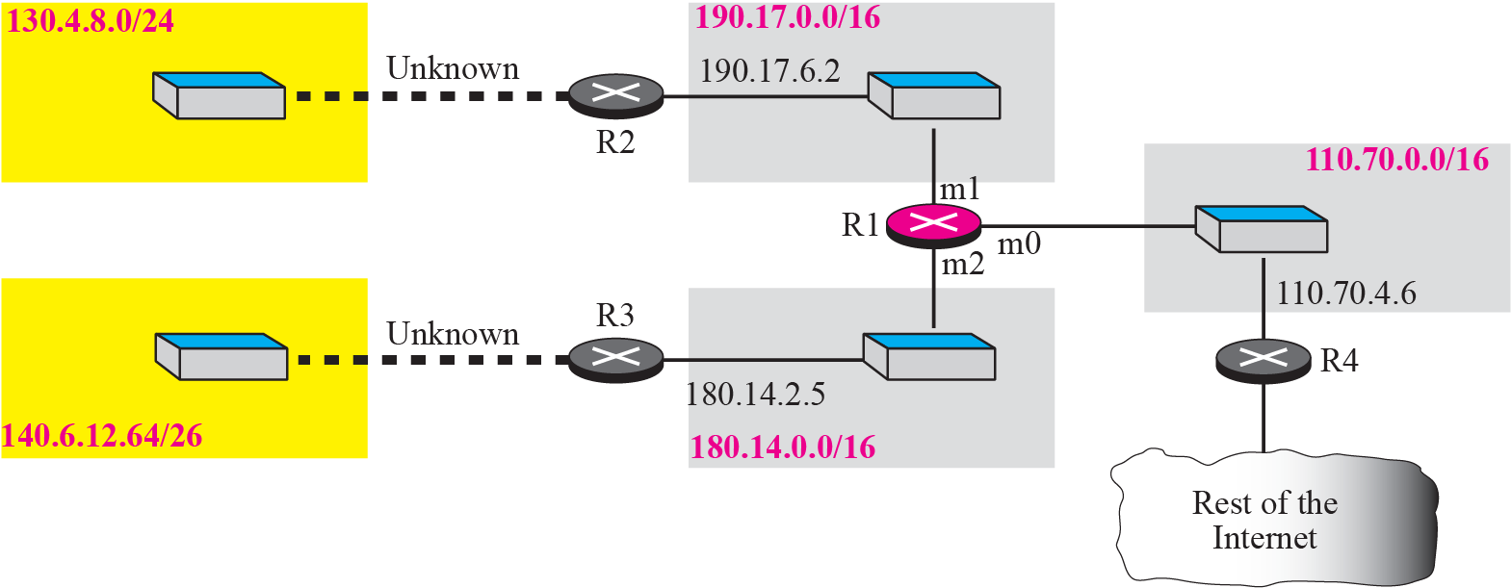
Guessed topology for Example 6

Slide 53
Address Aggregation
In classless address
The number of entries will increase
Since classless addressing is to divide up the whole address space into blocks
Problem:
Vast routing table and increased overhead to search table

Slide 54
Address Aggregation (Cont.)
Solutions: address aggregation
In the following figure
R1 has a longer routing table
Connect four organization
R2 has a small routing table
Any packet with destination 140.24.7.0~140.24.7.255 is sent out from interface m0
Regardless of the organization number
Called address aggregation
The blocks of addresses for four organization are aggregated into one large block
We do not have to specify each organization with an entry

Slide 55
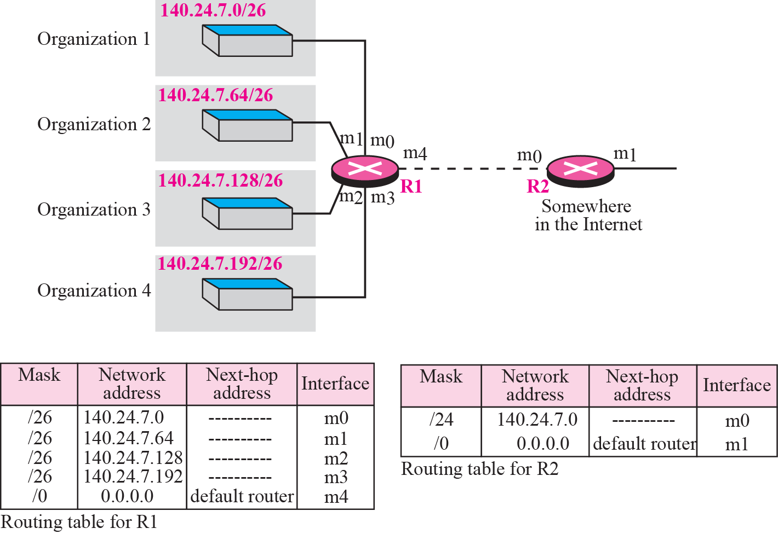
Address Aggregation

Slide 56
Longest Mask Matching
However, if organization 4 is not geographically close to the other three networks
Can we still use the address aggregation and assign 140.24.7.192/26 to organization 4?
Ans: Yes
Since routing in classless addressing uses longest mask matching
Longest mask matching
Routing table is sorted from the longest mask to the shortest mask
If there are three masks, /27, /26, /24
/27 is the first entry and /24 is the last one

Slide 57
Longest Mask Matching (Cont.)
Example, in the following figure
Organization 4 is moved
If an packet with destination address 140.24.7.200 is arrived at R2
The first mask at router R2 is applied => match
Route from interface m1 and reach organization 4
If not use longest mask matching
Apply the /24 mask would result in the incorrect routing
Thus
We can still aggregate organization 1~3 into a large block while still assign 140.24.7.192/26 to organization 4

Slide 58
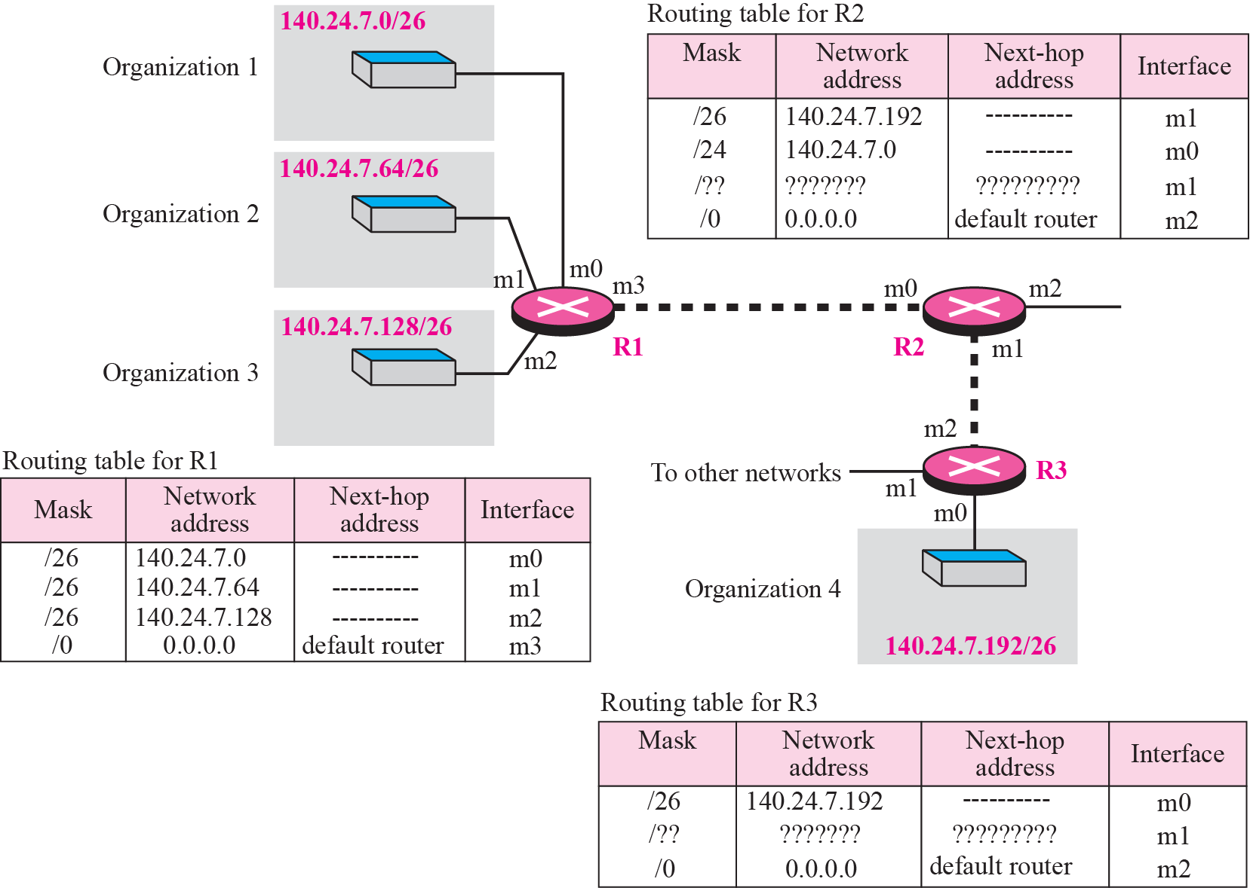
Longest Mask Matching (Cont.)

Slide 59
Hierarchical Routing
To further reduce the size of routing table
Create a sense of hierarchy in the Internet architecture and routing tables
Internet is divided into international and national ISP
National ISP are divided into regional ISPs
Regional ISP are divided into local ISPs
If a local ISP divide its block (a.b.c.d/n) into smaller blocks
However, to the rest of the Internet, routers do not know such a division
Thus, all customers of the local ISP are still defined as a.b.c.d/n to the rest of Internet

Slide 60
Example 12
Consider the following figure
A regional ISP is granted 16384 addresses starting from 120.14.64.0/18
The regional ISP has decided to divide this block into four subblocks, each with 4096 addresses.
Three of these subblocks are assigned to three local ISPs,
The second subblock is reserved for future use

Slide 61
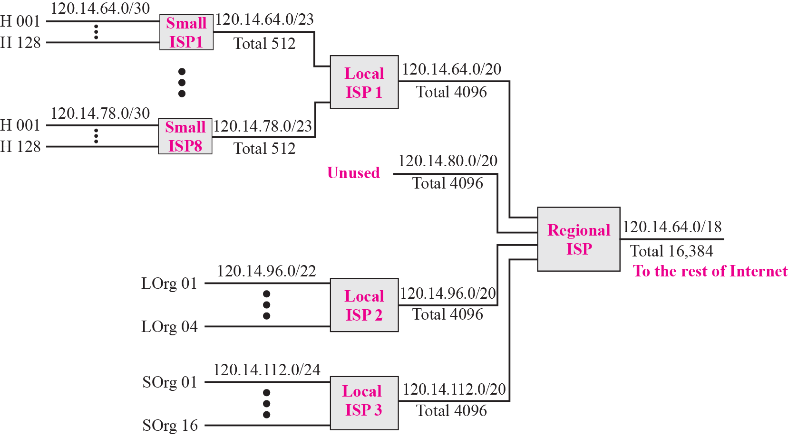
Hierarchical Routing with ISPs

Slide 62
Example 12 (Cont.)
The first local ISP has divided its assigned subblock into 8 smaller blocks
Assigned each to a small ISP.
Each small ISP provides services to 128 households (H001 to H128), each using four addresses.
The second local ISP has divided its block into 4 blocks
Assigned the addresses to 4 large organizations (LOrg01 to LOrg04).
The third local ISP has divided its block into 16 blocks
Assigned each block to a small organization (SOrg01 to SOrg15).

Slide 63
Example 12 (Cont.)
There is a sense of hierarchy in this configuration.
All routers in the Internet send a packet with destination address 120.14.64.0 to 120.14.127.255 to the regional ISP.
The regional ISP sends every packet with destination address 120.14.64.0 to 120.14.79.255 to Local ISP1.
Local ISP1 sends every packet with destination address 120.14.64.0 to 120.14.64.3 to H001.

Slide 64
Geographical Routing
To decrease the size of the routing table even further
Extend hierarchical routing to include geographical routing
Divide the entire address space into a few large blocks
A block to North America
A block to Europe
A block to Asia
A block to Africa
The routers of ISP outside of Europe have only one entry for packets to Europe in their routing table

Slide 65
Routing Table Search Algorithm
The algorithms used in searching routing tables in classful addressing must be changed for classless addressing
The algorithm used for updating routing tables in classful addressing must be changed for classless addressing
Mentioned in Chapter 14

Slide 66
Searching in Classful Addressing
The routing table in classful addressing is organized as a list
However, to make search easier, the routing table can be divided into three buckets (areas)
One for each class

Slide 67
Searching in Classless Addressing
In classless routing, we can also use buckets
However, 32 buckets are used instead of three
Each buckets corresponding to each prefix length
When a packet arrives, try the longest prefix (/32), then the next prefix (/31) and so on until matched
Longest prefix match
However, this search method would also take quite a long time
Use other data structures such as tree or binary tree

Slide 68
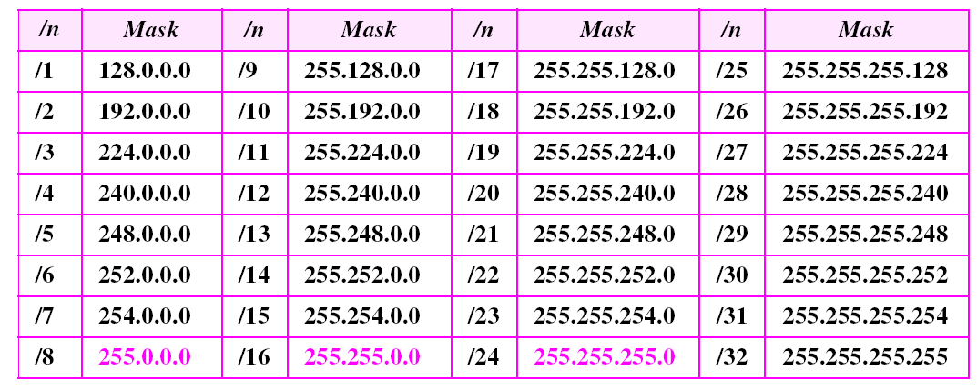
Prefix Lengths
Classful addressing is a special case of classless addressing.

Slide 69
Forwarding Based on Label (Skip in the Next Semester!)
In a connectionless network (datagram approach)
Forward packets based on destination address
Need to search the contents of a routing table
In a connection-oriented network (virtual-circuit approach)
Forward packets based on label
Accessing a table using an index
Routing involves searching; switching involves accessing

Slide 70
Example 6.13
Figure 6.18 shows a simple example of searching in a routing table using the longest match algorithm. When the forwarding algorithm gets the destination address of the packet, it needs to delve (探究) into the mask column. For each entry, it needs to apply the mask to find the destination network address. It then needs to check the network addresses in the table until it finds the match. The router then extracts the next hop address and the interface number to be delivered to the ARP protocol for delivery of the packet to the next hop.

Slide 71
Figure 6.18 Example 6.13: Forwarding based on destination address

Slide 72
Example 6.14 (Skip In Next Semester!)
Figure 6.19 shows a simple example of using a label to access a switching table. Since the labels are used as the index to the table, finding the information in the table is immediate.

Slide 73
Figure 6.19 Example 6.14: Forwarding based on label
Notes:
interface and
label address interface and
label address 0012

Slide 74
6.3
STRUCTURE OF
A ROUTER
The McGraw-Hill Companies, Inc., 2000

Slide 75
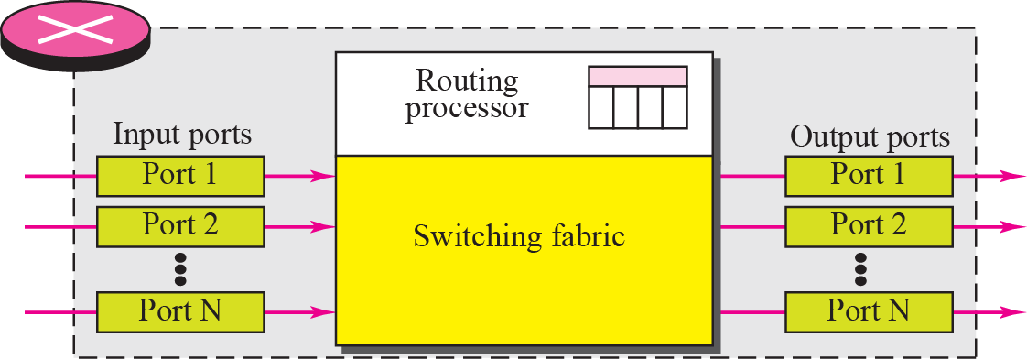
Router Components
A router has four components
Input port
Output port
Routing processor
Switching fabric

Slide 76
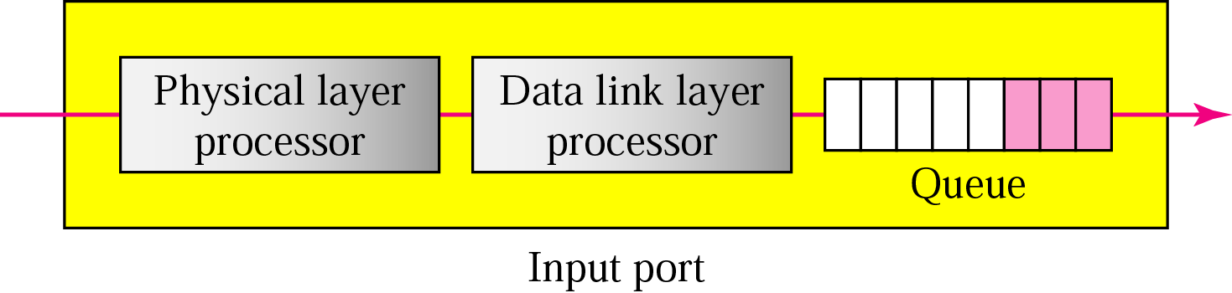
Input Port
Perform the physical and data link layer functions
Bits are constructed from the received signal
Packet is decapsulated from the frame
Errors are detected and corrected if possible
Buffered in queues before packets are directed to switching fabric

Slide 77
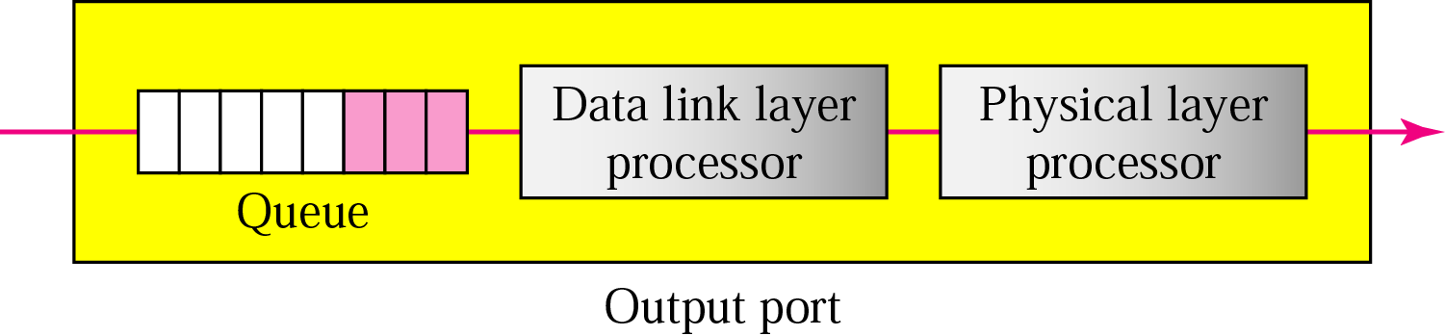
Output Ports
Perform the same functions as the input port, but in the reverse order
First, the outgoing packets are queued
Then the packet is encapsulated in a frame
Finally, the physical and MAC layer functions are applied to send the frame

Slide 78
Routing Processor
Perform the functions of the network layer
Perform table lookup
Search routing table to find the address of the next hop and the output port number

Slide 79
Switching Fabrics
Most difficult task in a router
Move the packet from the input queue to the output queue
The speed affects
The size of the input/output queue
The overall delay in packet delivery
Solution: switch fabrics
Some of the fabrics
Crossbar Switch
Banyan Switch
Batcher-Banyan Switch

Slide 80
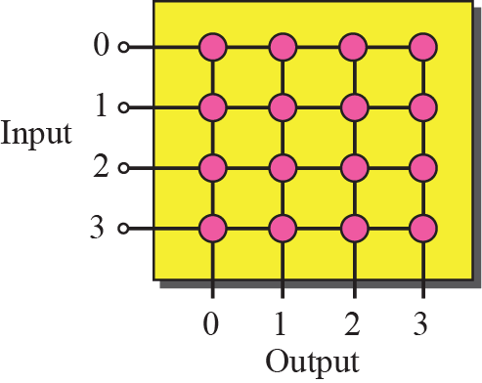
Crossbar Switch
Connect n inputs to n output in a grid
Each crosspoint has a electronic microswitch

Slide 81
Banyan Switch
A multistage switch
A microswitches at each stage that route packets based on the output port represented as a binary string
For n input and n output, we have log₂(n) stages
At each stage, we need n/2 microswitches
See the following figure
The number of stages is log₂(8) = 3
The first stage routes packets based on the highest bit of the binary string, and so on
Elegant design that every input port can connect to any one output port

Slide 82
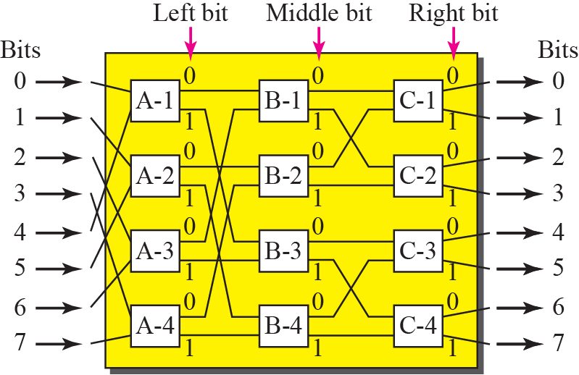
A Banyan Switch

Slide 83
Banyan Switch (Cont.)
In the next slide
A packet has arrived at input port 1 and go to output port 6 (110 in binary)
First microswtich (A-2) routes the packet based on the first bit (1)
Second microswtich (B-4) routes the packet based on the second bit (1)
Third microswtich (C-4) routes the packet based on the third bit (0)

Slide 84
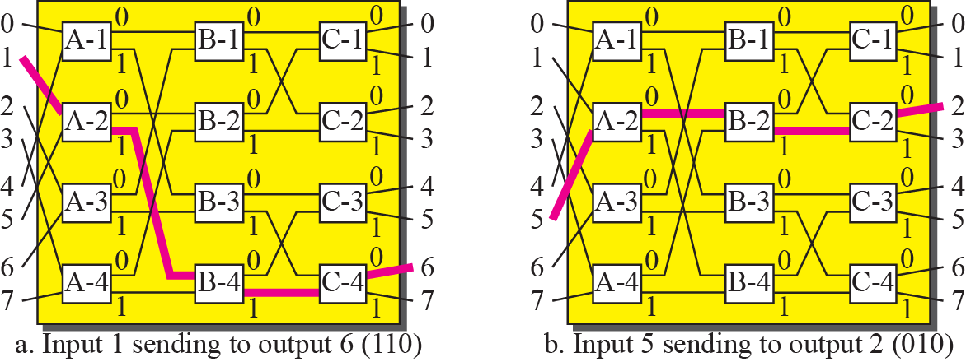
Examples of Routing in a Banyan Switch

Slide 85
Batcher-Banyan Switch
Problem with the banyan switch
The possibility of internal collisions even when two packets are not heading for the same output port
One solutions: Batcher-Banyan Switch
Sort the incoming packets according to their final destination

Slide 86
Batcher-Banyan Switch (Cont.)
Batch-Banyan Switch
A combination of batcher switch and banyan switch
A trap is added between batcher switch and banyan switch
Prevent packets with the same output destination from passing the banyan switch simultaneously
Only one packet for each destination is allowed at each tick

Slide 87
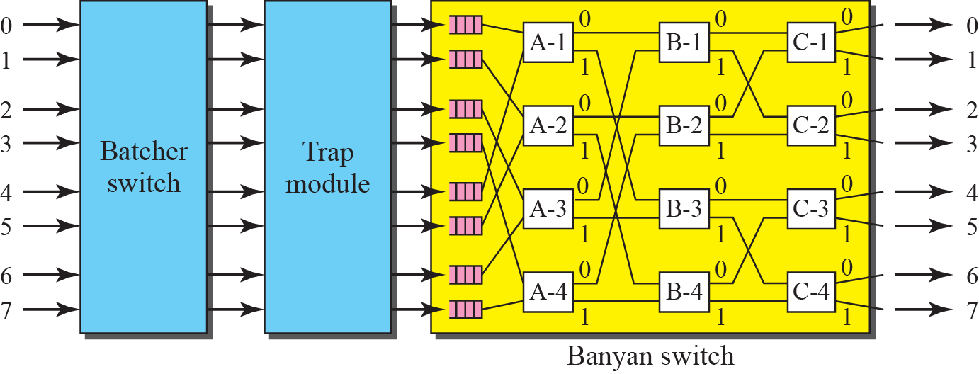
Batcher-Banyan Switch

